Slide 1
ECE408 /CS483/CSE408 Spring 2018 Applied Parallel Programming Lectures 2: Introduction to CUDA C and Data Parallel Programming

Slide 2
Objective
To learn the basic concept of data parallel computing
To learn the basic features of the CUDA C programming interface

Slide 3

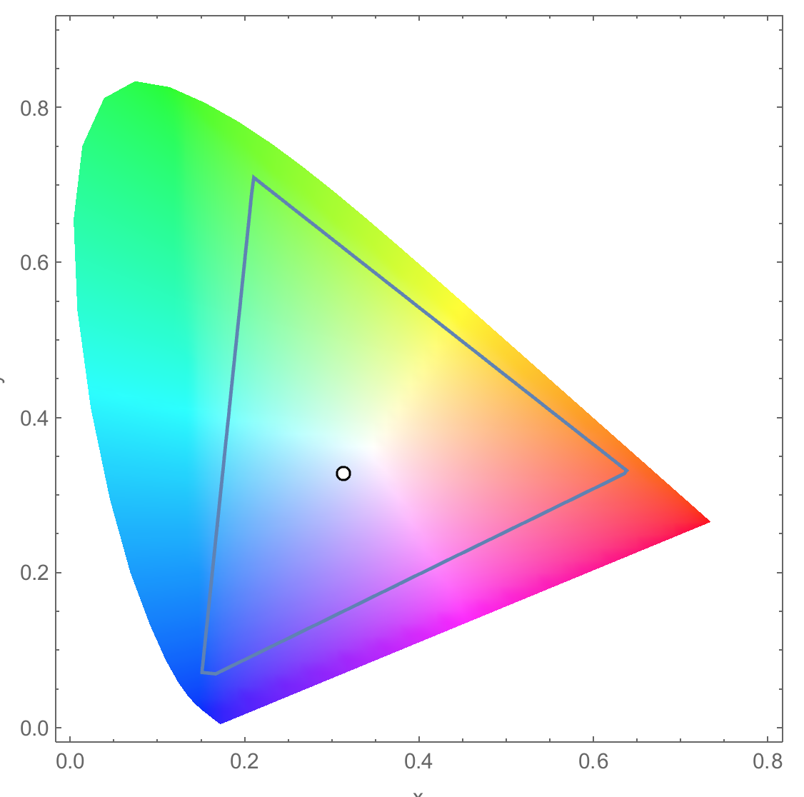
A Data Parallel Computation Example: Conversion of a color image to grey–scale image

Slide 4
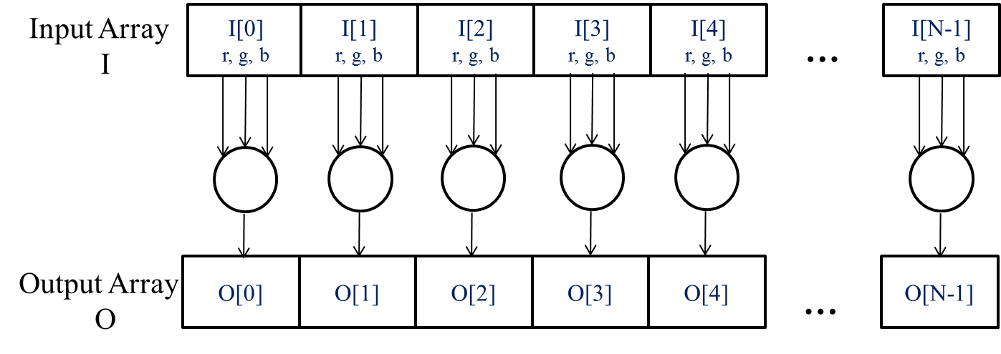
The pixels can be calculated independently of each other

Slide 5
CUDA/OpenCL – Execution Model
Integrated host+device app C program
Serial or modestly parallel parts in host C code
Highly parallel parts in device SPMD kernel C code
Serial Code (host)‏
Parallel Kernel (device)‏
KernelA<<< nBlk, nTid >>>(args);
. . .
Serial Code (host)‏
Parallel Kernel (device)‏
KernelB<<< nBlk, nTid >>>(args);
. . .

Slide 6
Arrays of Parallel Threads
A CUDA kernel is executed by a grid (array) of threads
All threads in a grid run the same kernel code (SPMD)‏
Each thread has an index that it uses to compute memory addresses and make control decisions
threadIdx.x –
Index within a block
0
1
2
254
255
…
i = blockIdx.x * blockDim.x + threadIdx.x;
C[i] = A[i] + B[i];
…
6

Slide 7
Thread Blocks: Scalable Cooperation
Divide thread array into multiple blocks
Threads within a block cooperate via shared memory, atomic operations and barrier synchronization (to be covered later)
Threads in different blocks cooperate less (later)
Thread Block 0
Thread Block 1
Thread Block N-1
0
1
2
254
255
0
1
2
254
255
0
1
2
254
255
…
…
…
i = blockIdx.x * blockDim.x + threadIdx.x;
C[i] = A[i] + B[i];
i = blockIdx.x * blockDim.x + threadIdx.x;
C[i] = A[i] + B[i];
i = blockIdx.x * blockDim.x + threadIdx.x;
C[i] = A[i] + B[i];
…
…
…
…

Slide 8
blockIdx and threadIdx
Each thread uses indices to decide what data to work on
blockIdx: 1D, 2D, or 3D threadIdx: 1D, 2D, or 3D
Simplifies memory addressing when processing multidimensional data
Image processing
Vectors, matrices, tensors
Solving PDEs on volumes
…

Slide 9
Vector Addition – Conceptual View
vector A
A[0]
A[1]
A[2]
A[3]
A[4]
A[N-1]
…
vector B
B[0]
B[1]
B[2]
B[3]
B[4]
…
B[N-1]
+
+
+
+
+
+
vector C
C[0]
C[1]
C[2]
C[3]
C[4]
C[N-1]
…

Slide 10
Vector Addition – Traditional C Code
// Compute vector sum C = A+B
void vecAdd(float* A, float* B, float* C, int n)
{
for (i = 0, i < n, i++)
C[i] = A[i] + B[i];
}
int main()
{
// Memory allocation for A_h, B_h, and C_h
// I/O to read A_h and B_h, N elements
…
vecAdd(A_h, B_h, C_h, N);
}

Slide 11
Heterogeneous Computing vecAdd Host Code
#include <cuda.h>
void vecAdd(float* A, float* B, float* C, int n)‏
{
int size = n* sizeof(float);
float* A_d, B_d, C_d;
…
1. // Allocate device memory for A, B, and C
// copy A and B to device memory
2. // Kernel launch code – to have the device
// to perform the actual vector addition
3. // copy C from the device memory
// Free device vectors
}

Slide 12
Partial Overview of CUDA Memories
Device code can:
R/W per-thread registers
R/W per-grid global memory
Host code can
Transfer data to/from per grid global memory
(Device) Grid
Block (0, 0)
Block (1, 0)
Registers
Registers
Registers
Registers
Thread (0, 0)
Thread (1, 0)
Thread (0, 0)
Thread (1, 0)
We will cover more later.
Host
Global
Memory
Notes:
Global, constant, and texture memory spaces are persistent across kernels called by the same application.

Slide 13
CUDA Device Memory Management API functions
cudaMalloc()
Allocates object in the device global memory
Two parameters
Address of a pointer to the allocated object
Size of the allocated object in terms of bytes
cudaFree()
Frees object from device global memory
Pointer to freed object
Grid
Block (0, 0)
Block (1, 0)
Registers
Registers
Registers
Registers
Thread (0, 0)
Thread (1, 0)
Thread (0, 0)
Thread (1, 0)
Host
Global Memory

Slide 14
Host-Device Data Transfer API functions
cudaMemcpy()
memory data transfer
Requires four parameters
Pointer to destination
Pointer to source
Number of bytes copied
Type/Direction of transfer
(Device) Grid
Block (0, 0)
Block (1, 0)
Registers
Registers
Registers
Registers
Thread (0, 0)
Thread (1, 0)
Thread (0, 0)
Thread (1, 0)
Host
Global
Memory

Slide 15
void vecAdd(float* A, float* B, float* C, int n)
{
int size = n * sizeof(float);
float* A_d, B_d, C_d;
1. // Transfer A and B to device memory
cudaMalloc((void **) &A_d, size);
cudaMemcpy(A_d, A, size, cudaMemcpyHostToDevice);
cudaMalloc((void **) &B_d, size);
cudaMemcpy(B_d, B, size, cudaMemcpyHostToDevice);
// Allocate device memory for
cudaMalloc((void **) &C_d, size);
2. // Kernel invocation code – to be shown later
…
3. // Transfer C from device to host
cudaMemcpy(C, C_d, size, cudaMemcpyDeviceToHost);
// Free device memory for A, B, C
cudaFree(A_d); cudaFree(B_d); cudaFree (C_d);
}

Slide 16
Example: Vector Addition Kernel
Device Code
// Compute vector sum C = A+B
// Each thread performs one pair-wise addition
__global__
void vecAddKernel(float* A_d, float* B_d, float* C_d, int n)
{
int i = blockIdx.x * blockDim.x + threadIdx.x ;
if(i<n) C_d[i] = A_d[i] + B_d[i];
}
int vectAdd(float* A, float* B, float* C, int n)
{
// A_d, B_d, C_d allocations and copies omitted
// Run ceil(n/256) blocks of 256 threads each
vecAddKernel<<<ceil(n/256.0), 256>>>(A_d, B_d, C_d, n);
}

Slide 17
Example: Vector Addition Kernel
// Compute vector sum C = A+B
// Each thread performs one pair-wise addition
__global__
void vecAddkernel(float* A_d, float* B_d, float* C_d, int n)
{
int i = blockIdx.x * blockDim.x + threadIdx.x;
if(i<n) C_d[i] = A_d[i] + B_d[i];
}
int vecAdd(float* A, float* B, float* C, int n)
{
// A_d, B_d, C_d allocations and copies omitted
// Run ceil(n/256) blocks of 256 threads each
vecAddKernnel<<<ceil(n/256.0),256>>>(A_d, B_d, C_d, n);
}
Host Code

Slide 18
More on Kernel Launch
Equivalent Host Code
int vecAdd(float* A, float* B, float* C, int n)
{
// A_d, B_d, C_d allocations and copies omitted
// Run ceil(n/256) blocks of 256 threads each
dim3 DimGrid(n/256, 1, 1);
if (n%256) DimGrid.x++;
dim3 DimBlock(256, 1, 1);
vecAddKernel<<<DimGrid,DimBlock>>>(A_d, B_d, C_d, n);
}
Any call to a kernel function is asynchronous from CUDA 1.0 on, explicit synch needed for blocking

Slide 19
Kernel execution in a nutshell
__host__
Void vecAdd()
{
dim3 DimGrid(ceil(n/256.0),1,1);
dim3 DimBlock(256,1,1);
vecAddKernel<<<DimGrid,DimBlock>>>(A_d,B_d,C_d,n);
}
__global__
void vecAddKernel(float *A_d,
float *B_d, float *C_d, int n)
{
int i = blockIdx.x * blockDim.x
+ threadIdx.x;
if( i<n ) C_d[i] = A_d[i]+B_d[i];
}
Blk 0
Kernel
Blk N-1
• • •
Schedule onto multiprocessors
GPU
M0
Mk
• • •
RAM

Slide 20
More on CUDA Function Declarations
Executed on the:
Only callable from the:
__device__ float DeviceFunc()‏
device
device
__global__ void KernelFunc()‏
device
host
__host__ float HostFunc()‏
host
host
__global__ defines a kernel function
Each “__” consists of two underscore characters
A kernel function must return void
__device__ and __host__ can be used together

Slide 21
Compiling A CUDA Program
Integrated C programs with CUDA extensions
NVCC Compiler
Host Code
Device Code (PTX)
Host C Compiler/ Linker
Device Just-in-Time Compiler
Heterogeneous Computing Platform with
CPUs, GPUs

Slide 22
Questions?

